Slide 1

Enhancing Credit Card Approval Rate with Machine Learning
Presenter: Sumali Wickramarachchi

Slide 2


Current State of Credit Card Approval Process
Quest for enhancement
The Call to Adventure
AI enhanced Credit Card Approval Process
Data Transform
Classification
Validation
Regulatory Compliance
Personalised interest rates
Various stages from initial submission
Multiple credit committee process reviews
Operational Excellence
Profitability
Customer disputes
90% longer review periods vs instant approvals
Customer Satisfaction
Customer Dissatisfaction

Slide 3
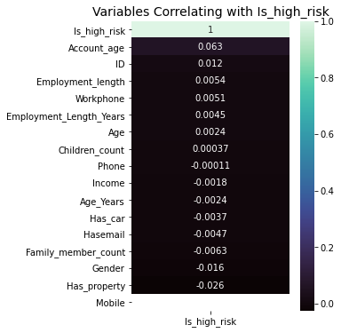
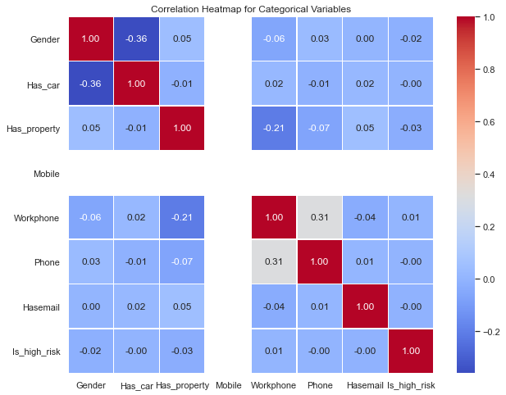

Data sets
Refining our tools
Credit History
Application Records
Setting up Y variable
Missing Values & Duplications
Outliers
Feature Engineering
Explorative Analysis

Slide 4

The First Tests Results
Baseline Model: Logistic Regression Model
Accuracy: Model accuracy is approximately 98.53%, indicating its overall performance.
Precision: Precision for 'not high risk' is high at 99%, but for 'high risk,' it's 0%.
Recall: Excellent recall for 'not high risk' at 100%, but 0% for 'high risk.'
F1-Score: High F1-score (around 0.99) for 'not high risk,' but 0 for 'high risk.'
Dear, High Risk Category

Slide 5


Iteration 1
Iteration 2
Iteration 3
The Allies and Enemies
Remove Multicollinearity
Log Transformation
Machine Learning Model Evaluation
Re-examine Linearity
Normality and Homoscedasticity
Logistic Regression Version 2
Gradient Boosting vs
Random Forest
High risk category accuracy still low

Slide 6
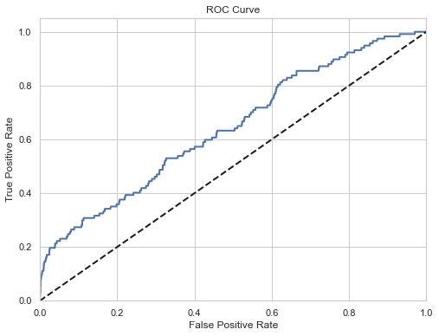
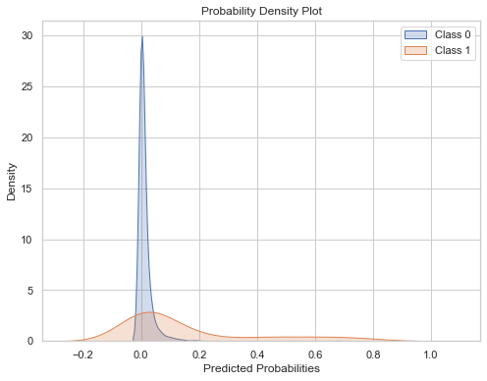
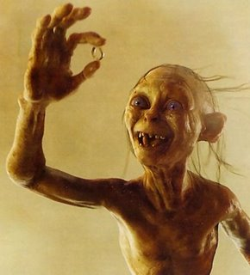
The Ultimate Choice: Random Forest
98% Accuracy for Low risk
28% Accuracy for High Risk
Precision: Precision for 'not high risk' is high at 99%, but for 'high risk,' it's only 28%.
Recall: Good recall for 'not high risk' at 99%, while for 'high risk,' it's 13%.
F1-Score: The F1-score for 'not high risk' is high at around 0.99, but for 'high risk,' it's 0.18.
Confusion Matrix: Most predictions are correct for 'not high risk' (7136 out of 7292) but relatively few for 'high risk' (15 out of 117).
ROC AUC Score: The model's ability to distinguish between high-risk and non-high-risk cases is moderate, with a score of approximately 0.56.

Slide 7
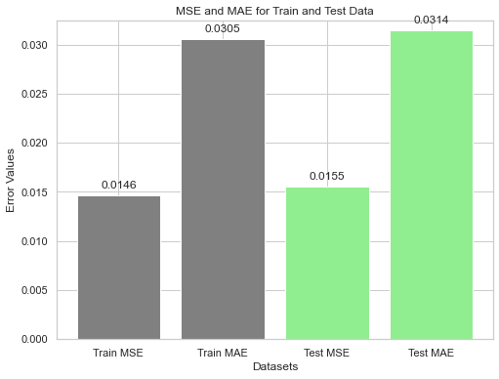
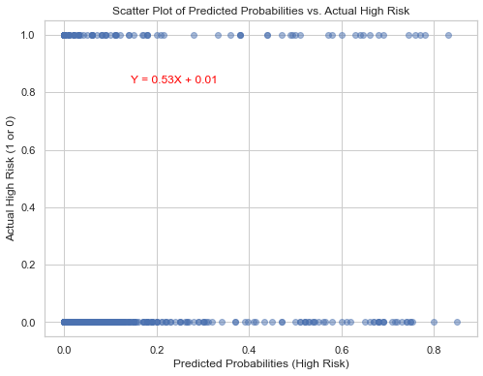
The Power of Model
Both training and test data exhibit low MSE and MAE values, indicating the model's effectiveness in minimizing prediction errors and its ability to generalize well to unseen data.
Next Steps
Resampling
New Variables (Credit Score, Real approval data)
Applicant Propensity Scoring
Train Data
Test Data
Train MSE: 0.0146 indicates small squared differences between predicted and actual values in the training data, reflecting a good model fit.
Train MAE: Approximately 0.0305 signifies small absolute differences between predicted and actual values in the training data, indicating an accurate model fit.
Test MSE: Around 0.0155 shows small squared differences between predicted and actual values in the test data, indicating strong model generalization.
Test MAE: Approximately 0.0314 suggests small absolute differences between predicted and actual values in the test data, confirming good model generalization.

Slide 8
Thank you!
Feel free to ask questions!

Slide 9
Thank you!
Sumali Wickramarachchi
sumaliwick11@gmail.com
GitHub: @SumaliWick
LinkedIn profile: Sumali Wickramarachchi
https://www.linkedin.com/in/sumali-wickramarachchi-3a296356/

